Slide 1

Chapter 8 – part II

Slide 2
OUTLINE
  Collisions.
  Center of mass.
  Problems.

Slide 3
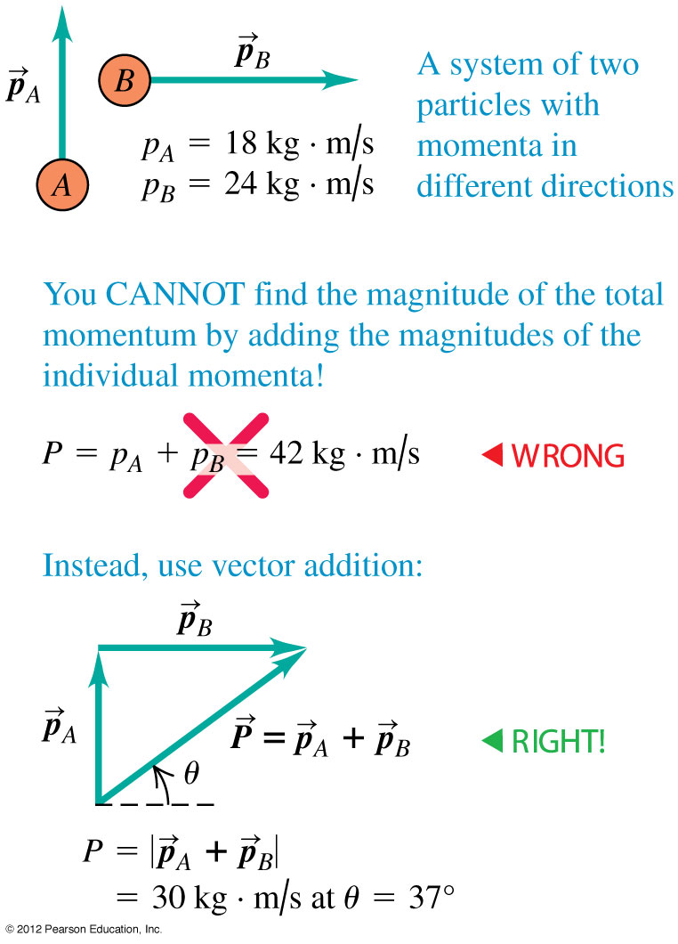
Remember that momentum is a vector!
  When applying conservation of momentum, remember that momentum is a vector quantity!
  Use vector addition to add momenta, as shown in the Figure at the right.

Slide 4
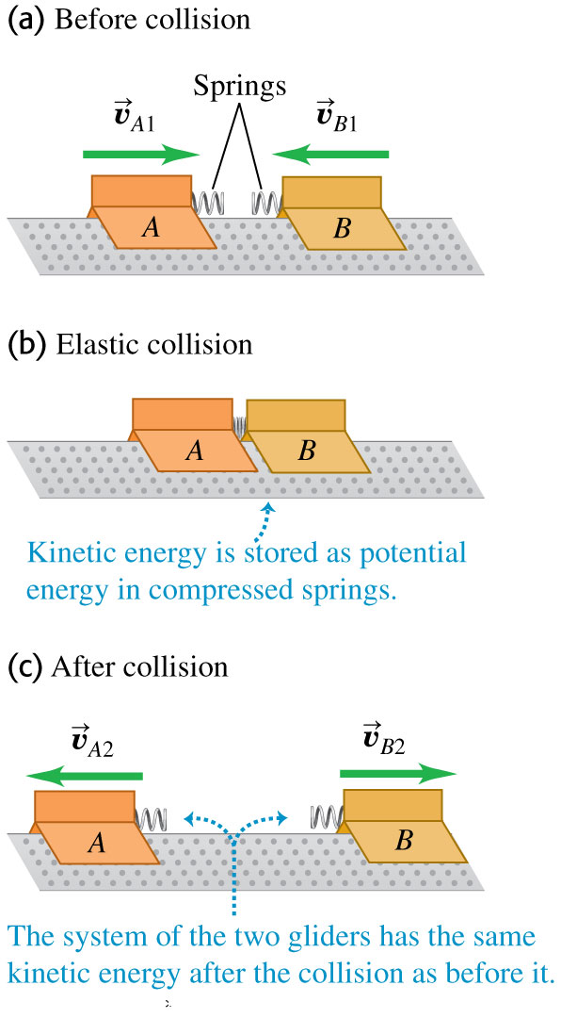
Elastic collisions
In an elastic collision, the total kinetic energy of the system is the same after the collision as before.
Figure at the left illustrates an elastic collision between air track gliders.

Slide 5
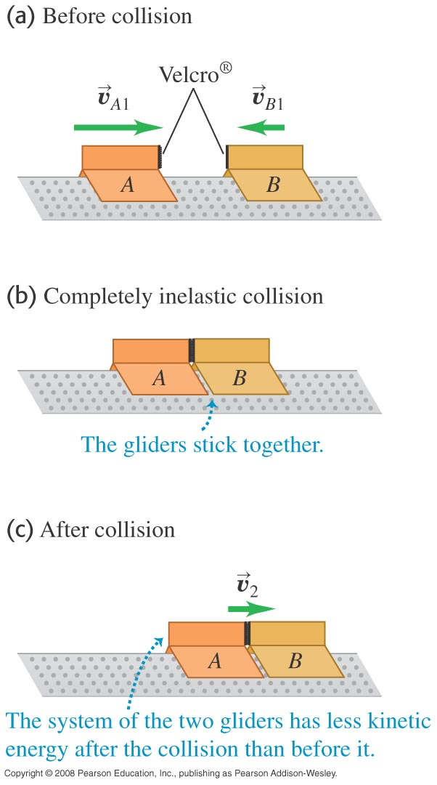
Inelastic collisions
In an inelastic collision, the total kinetic energy after the collision is less than before the collision.
A collision in which the bodies stick together is called a completely inelastic collision (see Figure at the right).
In any collision in which the external forces can be neglected, the total momentum is conserved.

Slide 6
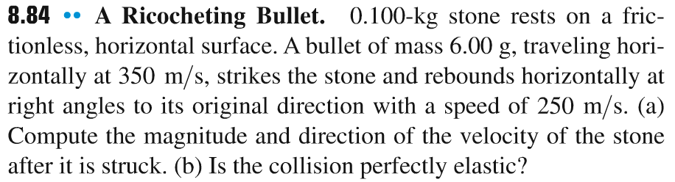
Problem #1

Slide 7
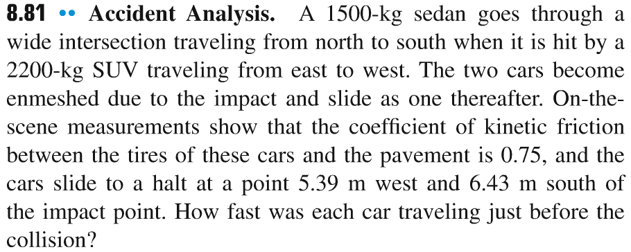
Problem #2

Slide 8
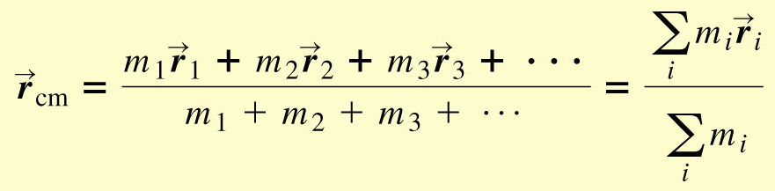

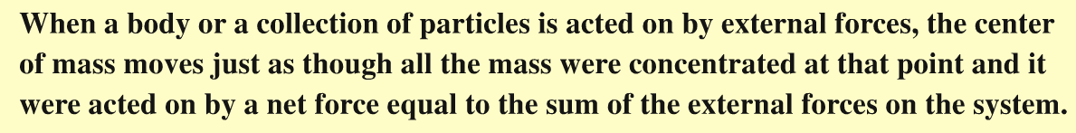
Center of mass
position vector of the center of mass
total momentum in terms of the center of mass
2nd law of Newton for the center of mass

Slide 9
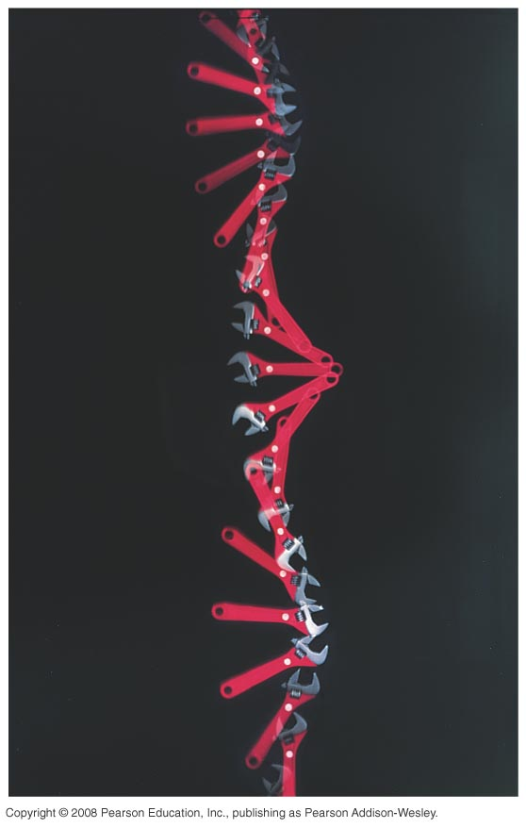
Motion of the center of mass
The total momentum of a system is equal to the total mass times the velocity of the center of mass.
The center of mass of the wrench in the figure at the right moves as though all the mass were concentrated there.

Slide 10
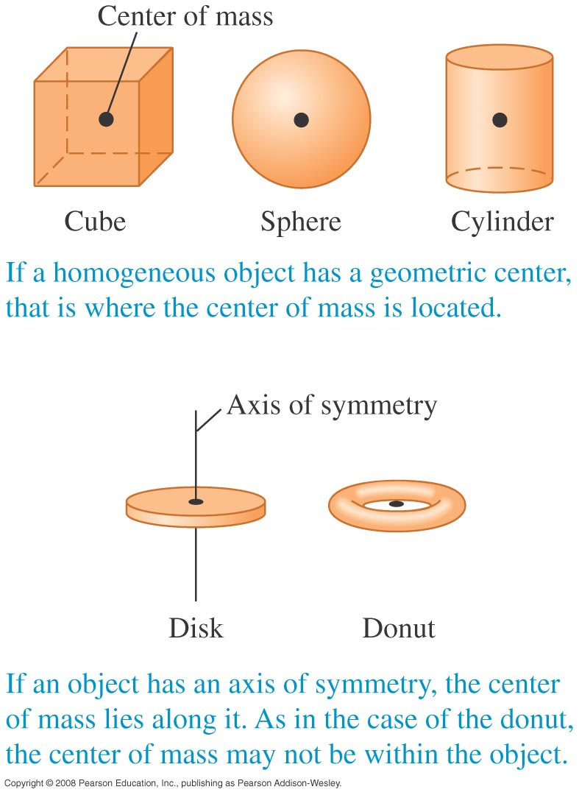
Center of mass of symmetrical objects

Slide 11
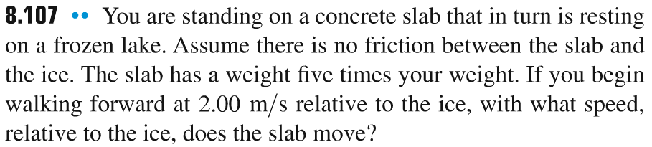
Problem #3

Slide 12
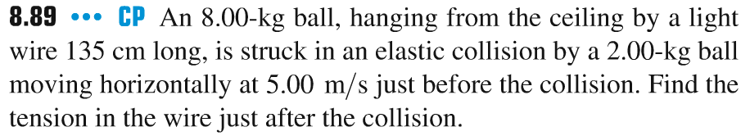
Problem #4

Slide 13

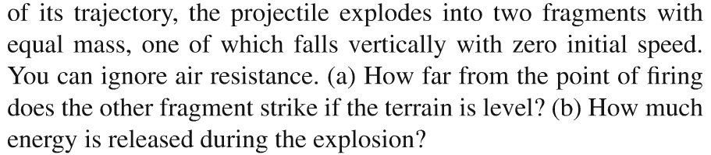
Problem #5

